Slide 1
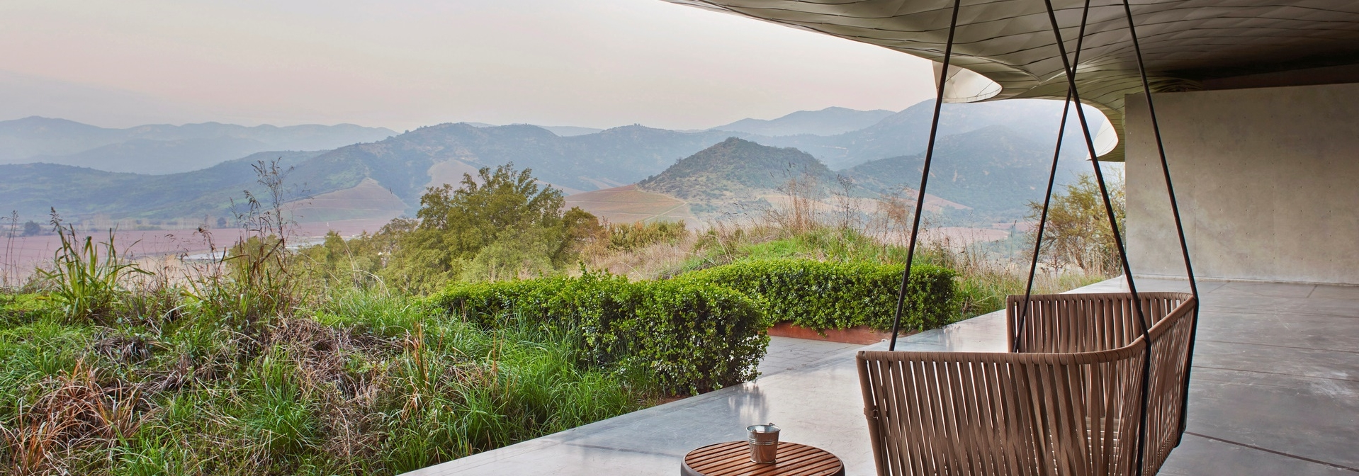
Project 2-Sydney House Price
Rachel Wang
Kane Moore
Paris Zhang

Slide 2




Content
About this project
Random Forest Model
Linear Regression Model

Slide 3


About This Project
This project is aiming to provide advise for property investors who are looking to purchase property in NSW. We extract data from Domain.com and collecting supportive data from official websites such as ABS and data.gov.au to provide analysis of current market trend and predict future trending of NSW real estate. The main machine learning utilized including Linear Regression and Random Forest. In this project, we are using different features to predict Sydney House Price trending in relation to both Microeconomic and Macroeconomic factors.

Slide 4



About This Project
Random Forest Model-We are predicting Sydney House Price trending in Macroeconomic perspective by utilizing Random Forest Model. Features we think would related to Sydney house pricing include CPI (Consumer Price Index), Interest rate (RBA cash rate), GDP (Gross Domestic Product), and AUD/USD exchange rate.
Linear Regression Model-We are also predicting Sydney House Price based on Microeconomic factors. We believe features such as income level, education level, distance from major employment centre, local crime rate, number and ranking of schools in LGA are main factors effecting house price.

Slide 5

Random Forest Model
Kane Moore

Slide 6
Random Forest Model
In this model, we import RandomForestClassifier and RandomeForestRegressor from sklearn.ensemble, StandardScaler from sklearn.preprocessing, train_test_split from sklear.model_selection, confusion_metrix, accuracy_score and classification_report from sklearn.metrics. We also import Dense from tensorflow.jeras.layers, Sequential from tensorflow.keras.models to proceed the analysis. In this model, we firstly cleaning feature data which were extracted from data.gov.au and ABS, then concat dataframes into one for feature variables followed by cross-referencing data extract from Domain API which is used as target variable. After that, we build and fit those variables into Random Forest Regressor Model. We also plotted those features to provide more visualized data. Finally, we train a neural network model to predict Sydney house price to see whether it may rise or fall in the future.

Slide 7
Linear Regression Model
Rachel Wang

Slide 8
Linear Regression Model
In this model, we mainly extract data from Domain API to call the most recent sales data, combine with other source website such as ABS, data.gov.au, ATO and police.nsw.gov.au to assist our analysis. Detailed features include housing price, number of bedrooms, number of bathrooms, number of carspaces, individual after tax income, renter rate, population density, incidents of assaults, and incidents of robbery, all those features are on Sydney suburb basis. We utilize interactive panel for price prediction and compare with the price range vendors ask for. Also we compare true house sold price with our predicted price via visualized plotting. Turned out our model is able to track the trend and give indications.

Slide 9
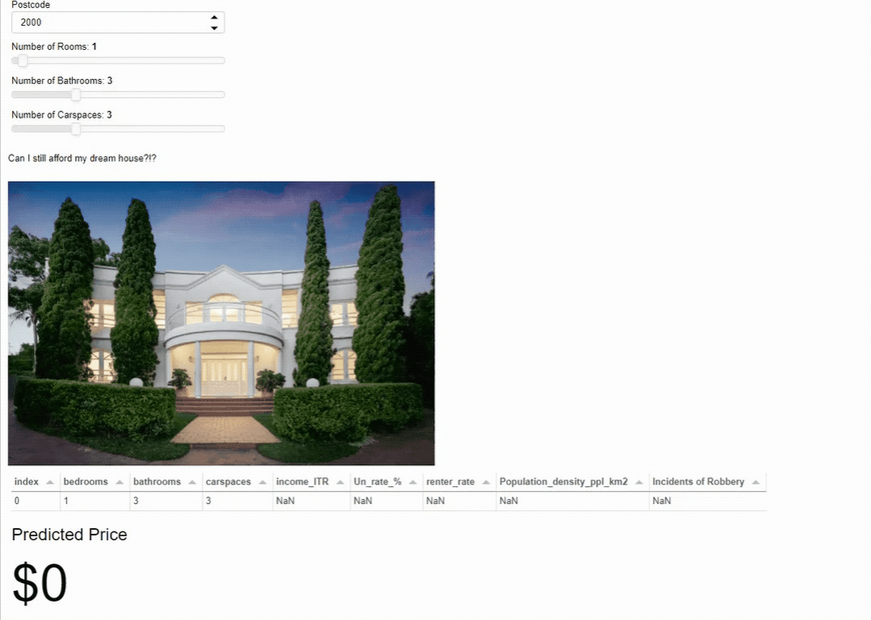
Predictor InAction

Slide 10

Thank You
Rachel Wang
Kane Moore
Paris Zhang

